Slide 1
Project Presentation
on
“Online Job Portal System.”
A java full stack job portal web application.
By
Mr. Shreyash Sandeep Jadhav.
[Unext ID :- Axis11JFSB1127]
Guided By
Mr. Safan Sir

Slide 2
Contents
Introduction
Technology used
Use Case Diagram
Spring boot + React JS architecture
Demo

Slide 3

Introduction
The main goal of this project is to develop an online
Job Search portal for the job seekers.
The purpose of online job portal is to automate the
Manual system by the help of computerized equipment's
And full fledged computer software.
Recruiters and job seekers from various company &
Domain will come ,engage with system and find their
Dream job.

Slide 4
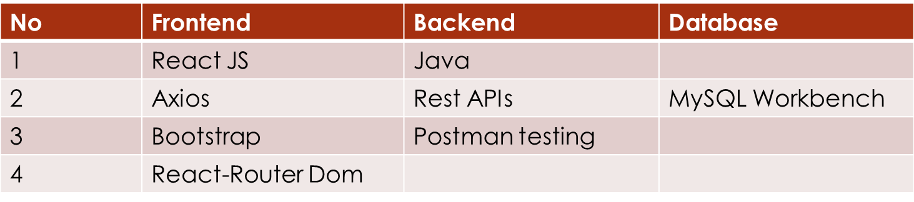
Technology & Tools
Tools Required :
1. MySQL workbench
2. Spring Tool Suite IDE
3. Postman
4. VS Code
II. Technology
Redux

Slide 5
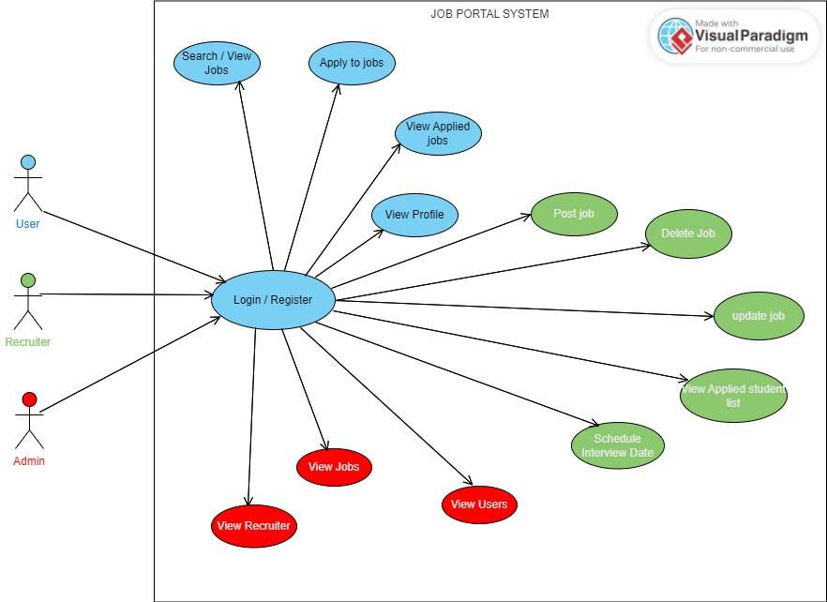
UseCase Diagram

Slide 6
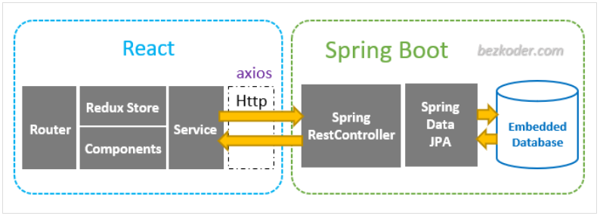
Architecture

Slide 7
T
a
y
k
o
h
n
u

Slide 8
Demo

